Slide 1
MICHIGAN MOOSE ASSOCIATION
MEMBERSHIP
&
RETENTION
Notes:
ROGER

Slide 2
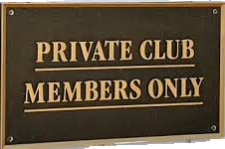
WHICH OF THESE THINGS MAKE YOUR
LODGE ATTRACTIVE TO NON-MEMBERS?
* PRODUCTS
*PRICING
*PEOPLE
*PLACE
*EVENTS
*SERVICES
Notes:
ROGER

Slide 3
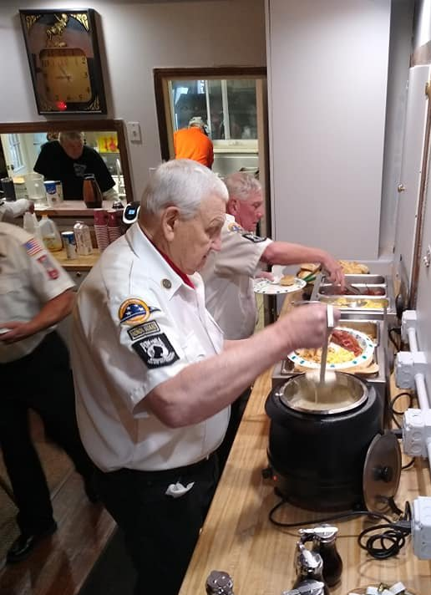
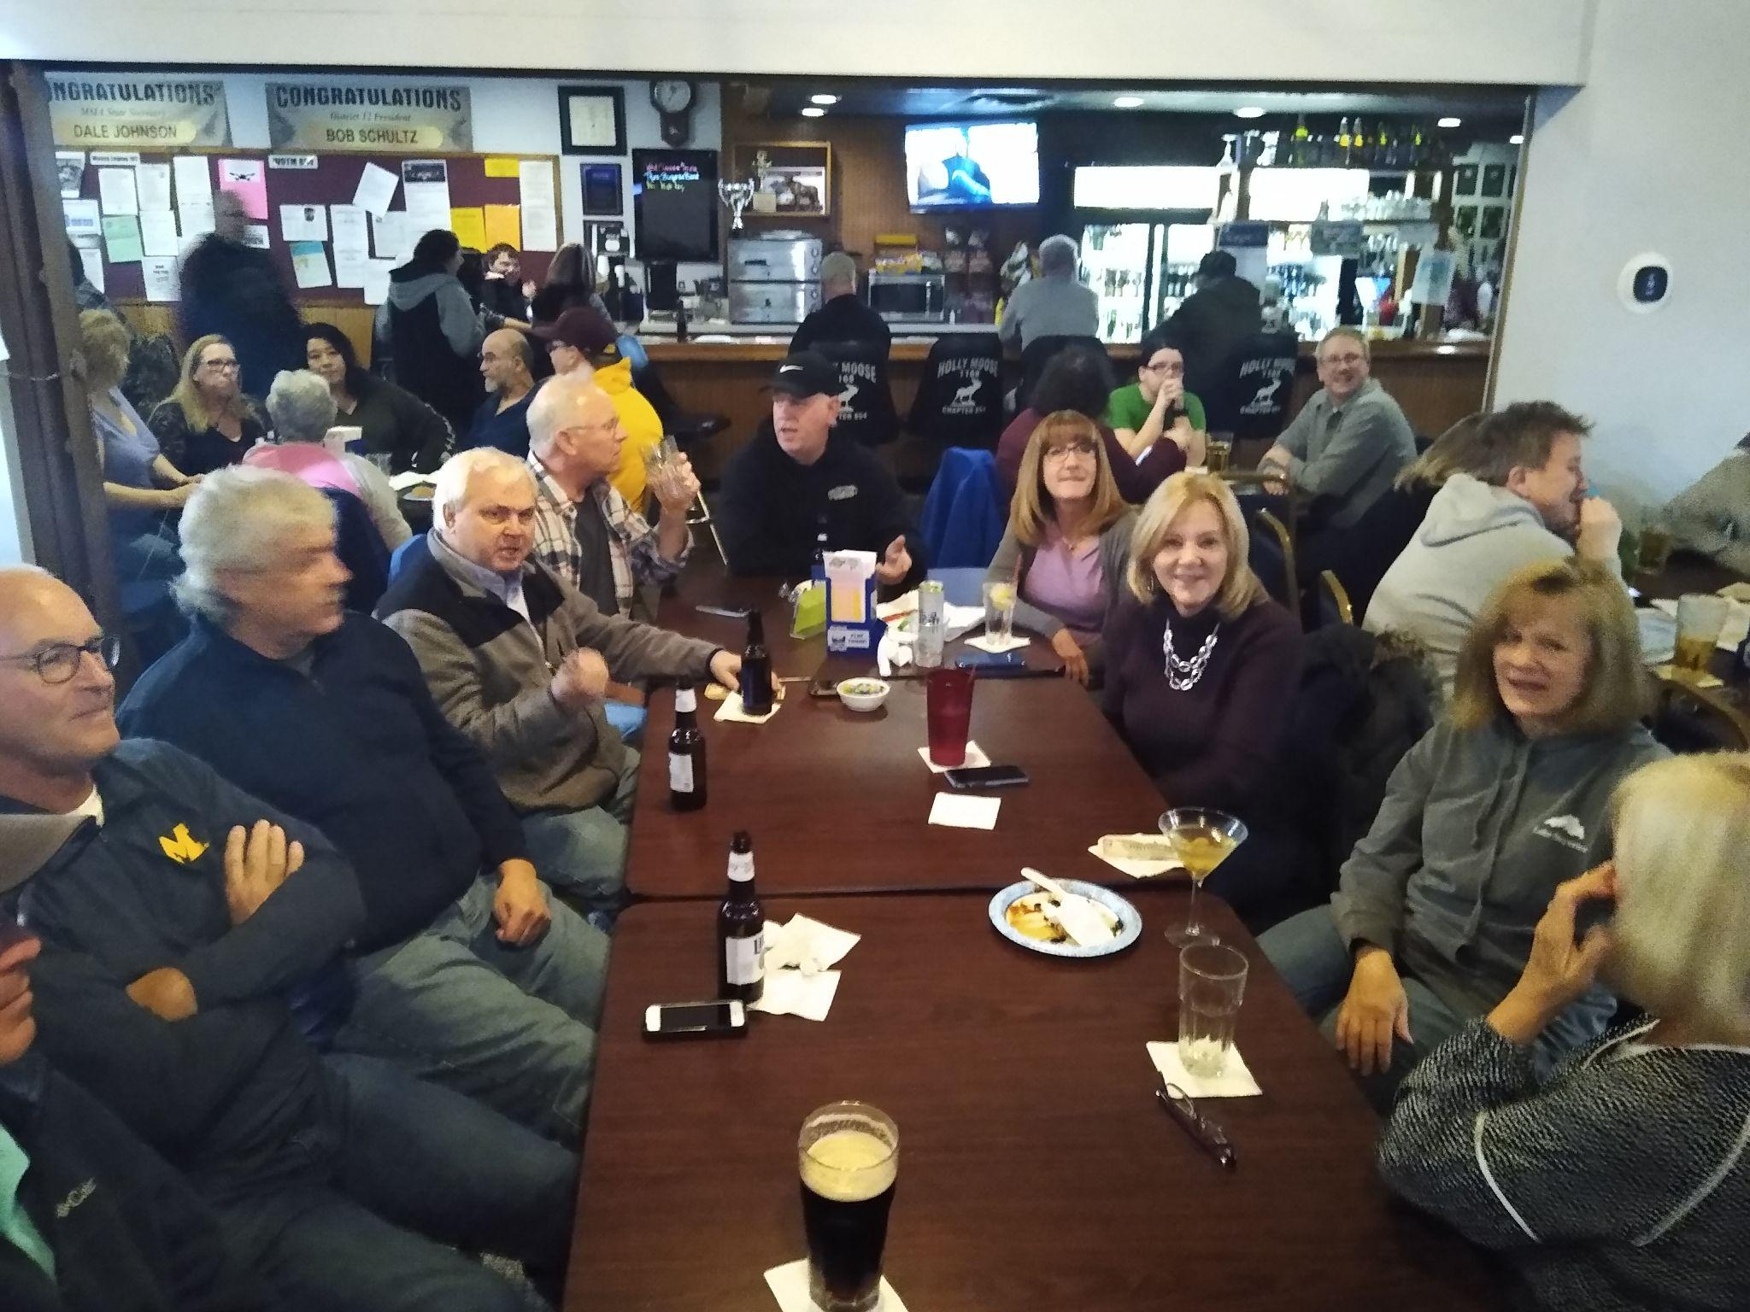
ALL
THE
ABOVE
Notes:
ROGER

Slide 4
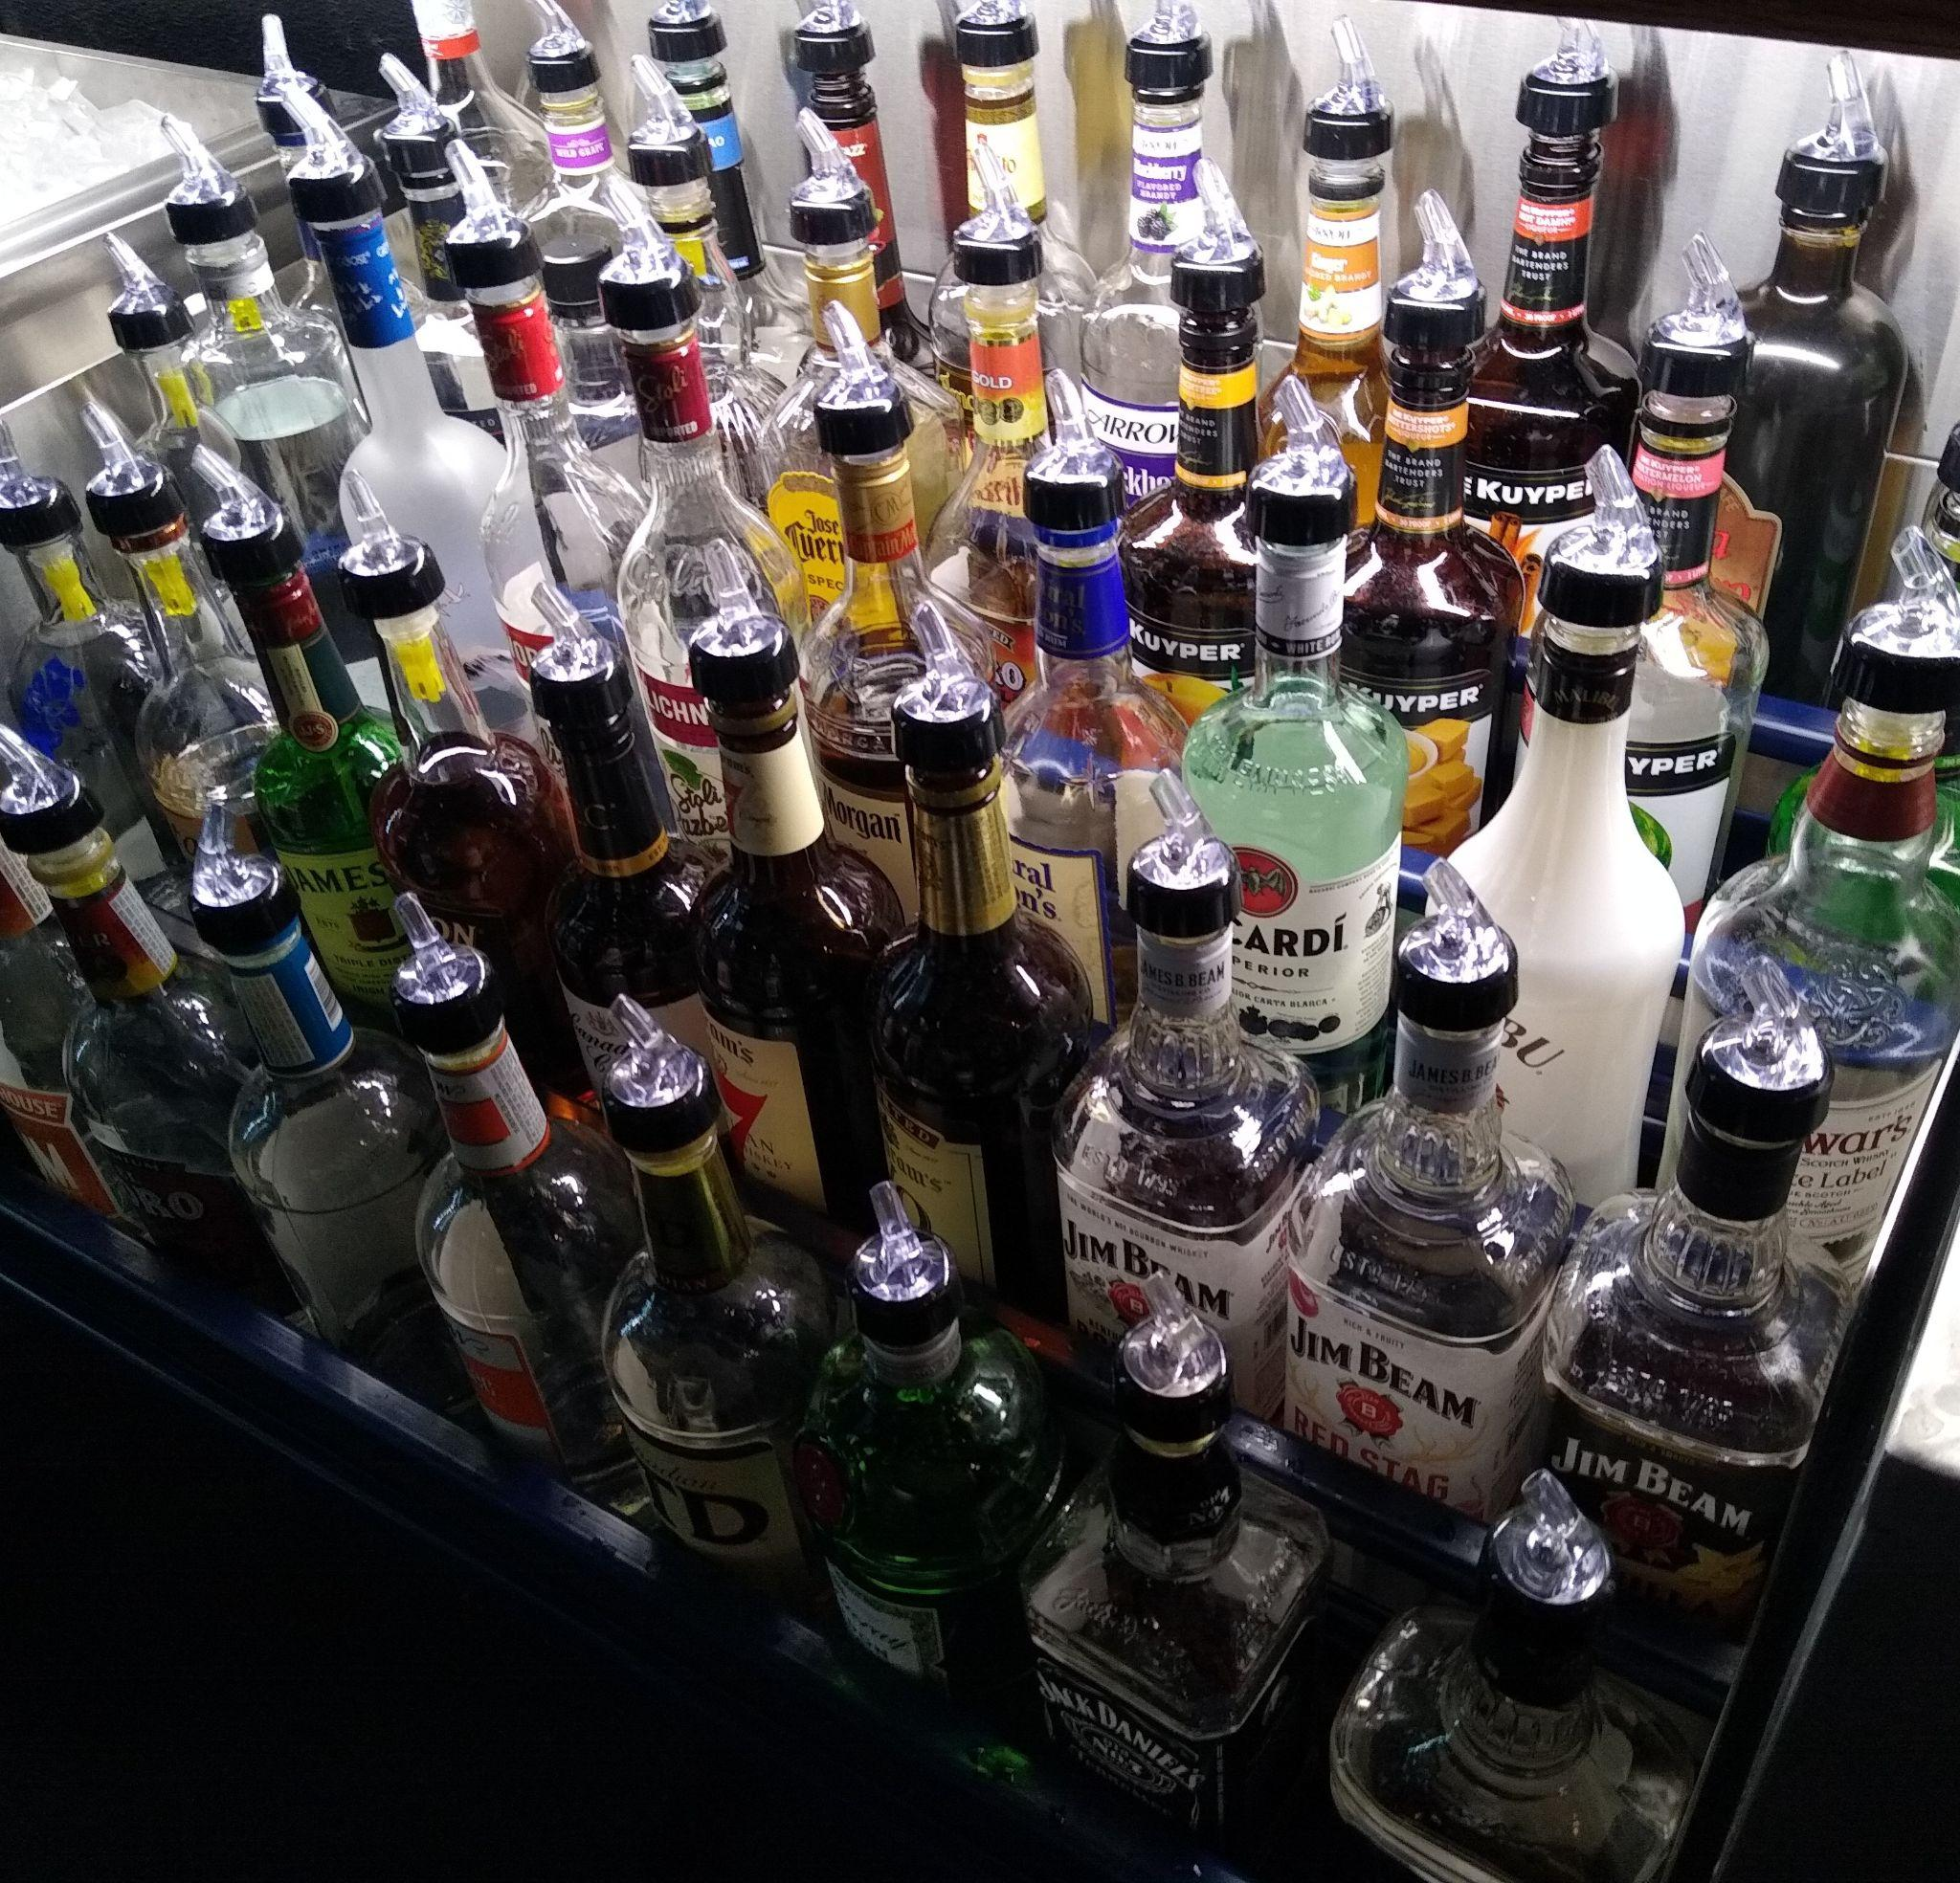
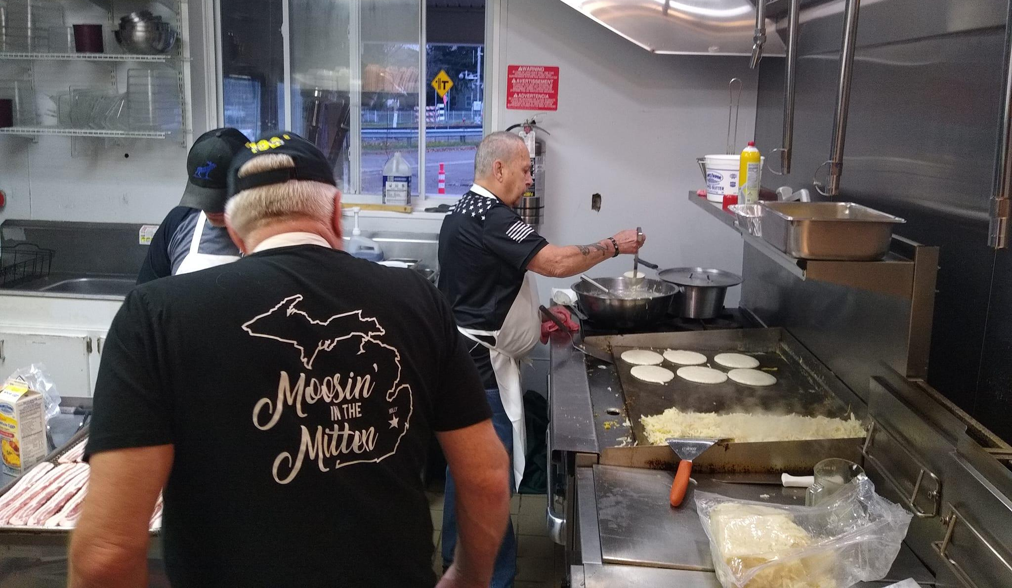
PRODUCT & PRICING
IS YOUR PRODUCT CONSISTENT?
Do you have all the favorites in stock?
Are your dinners consistent?
Is your pricing competitive without giving it away?
Notes:
ROGER

Slide 5
PLACE & PEOPLE
CLEAN
COMFORTABLE
FRIENDLY
INVITING
Notes:
ROGER & JILL

Slide 6
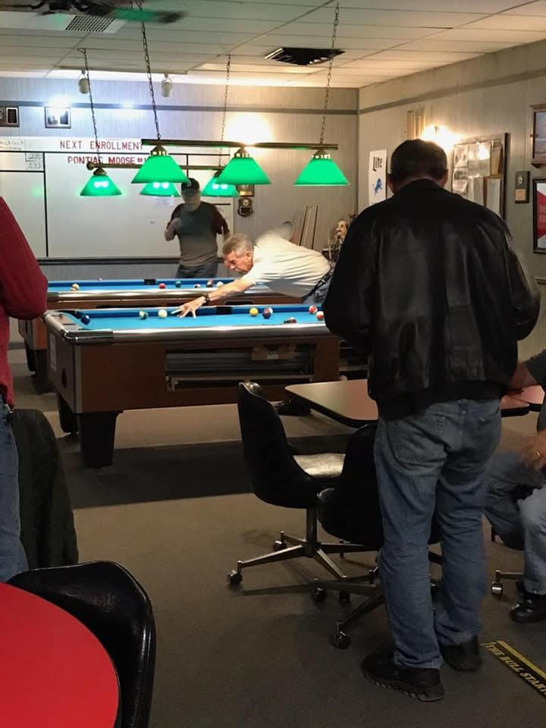
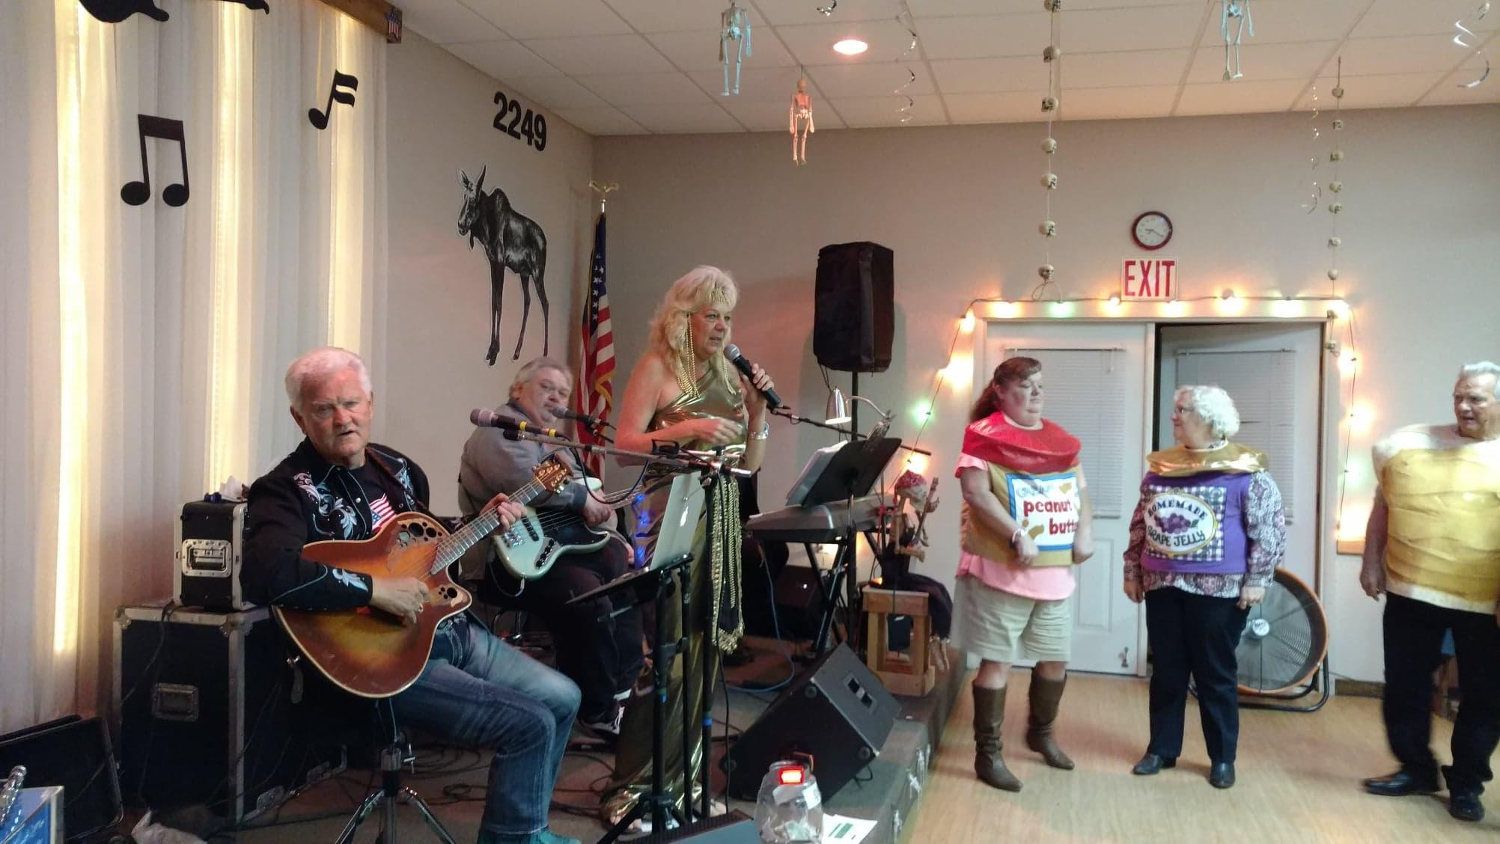
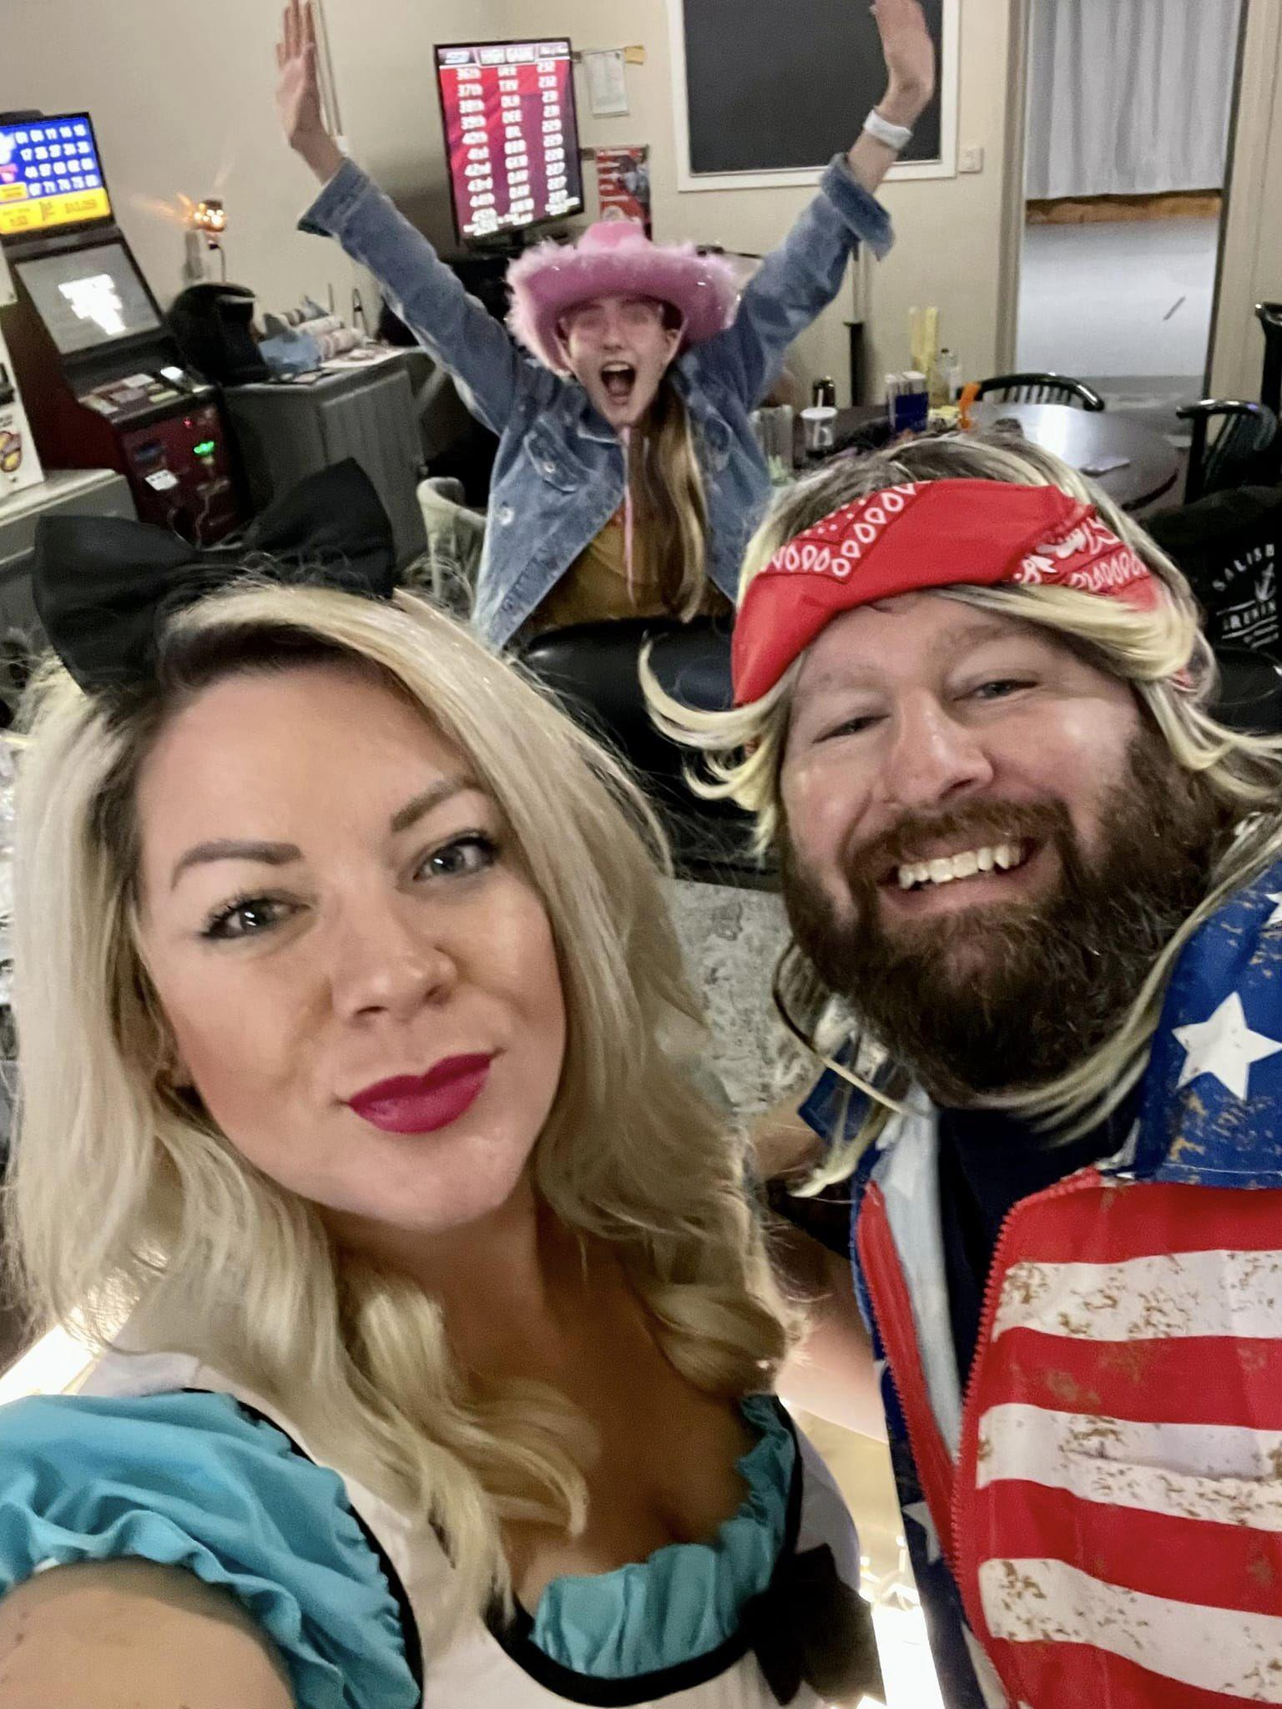
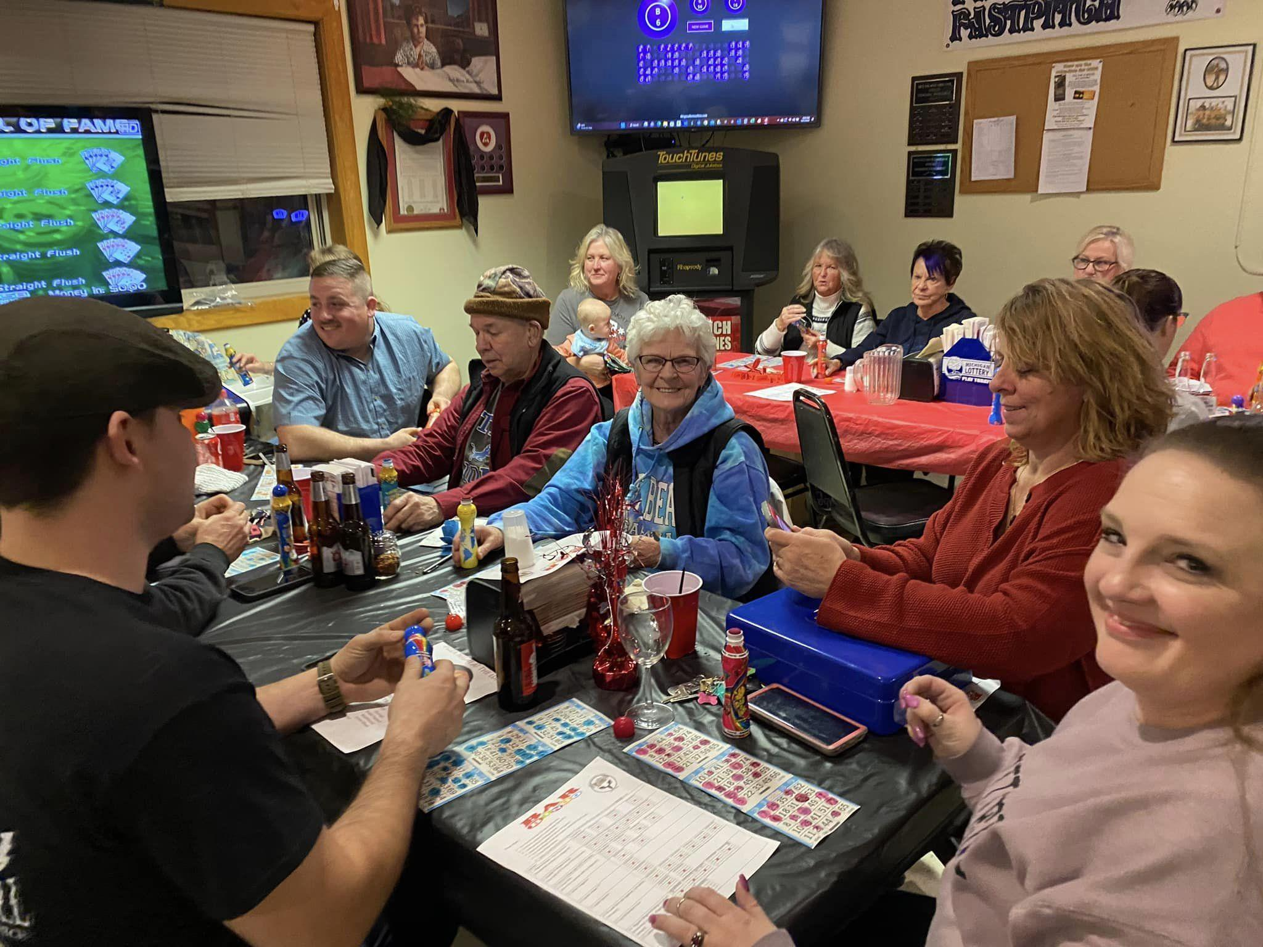
SERVICES & EVENTS
Notes:
ROGER TURN OVER TO JILL

Slide 7
COMMUNICATION
How does YOUR lodge communicate?
Notes:
JILL

Slide 8
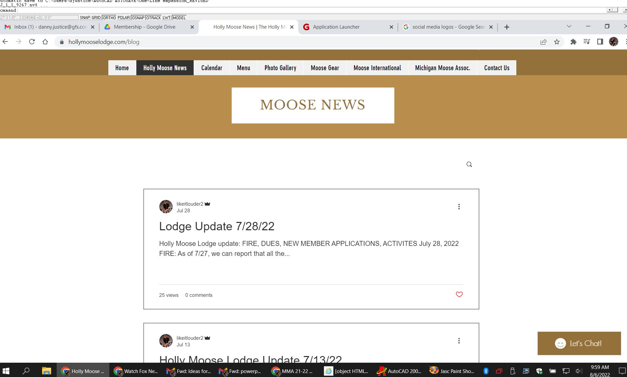
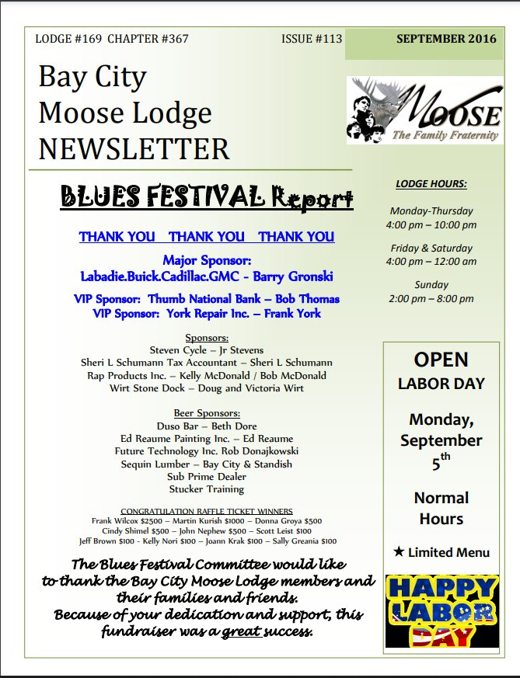
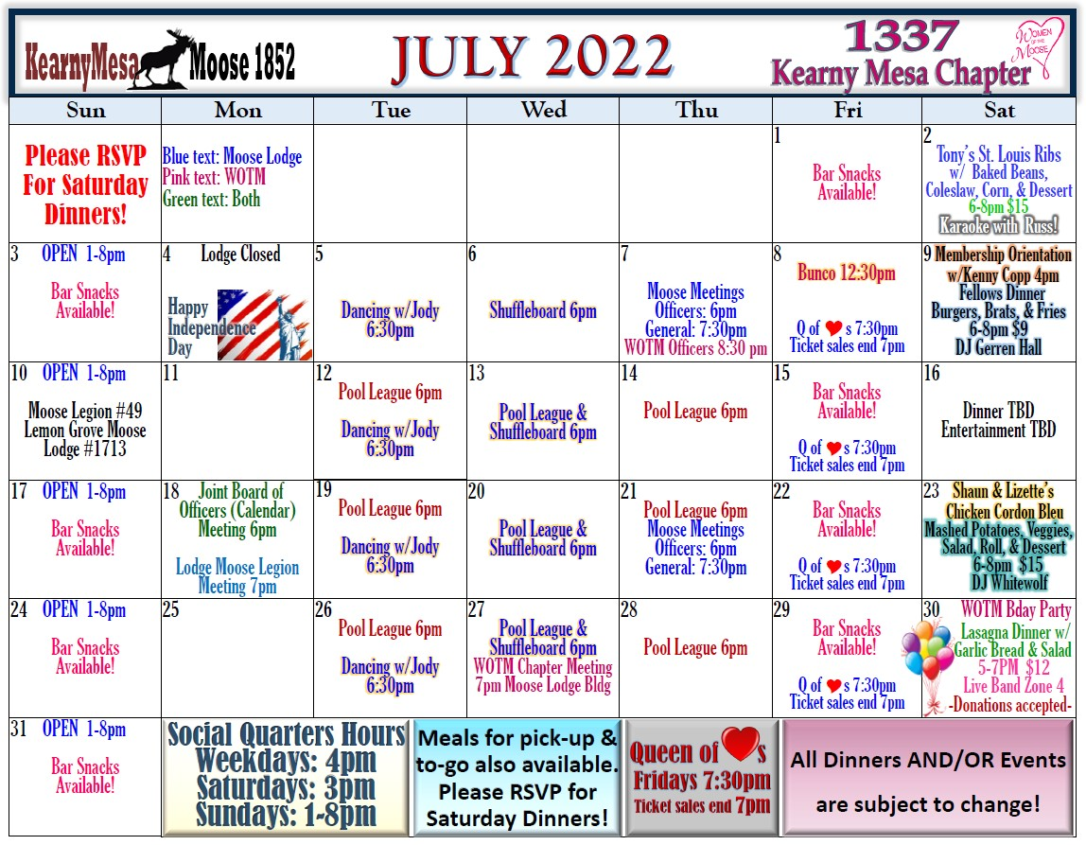
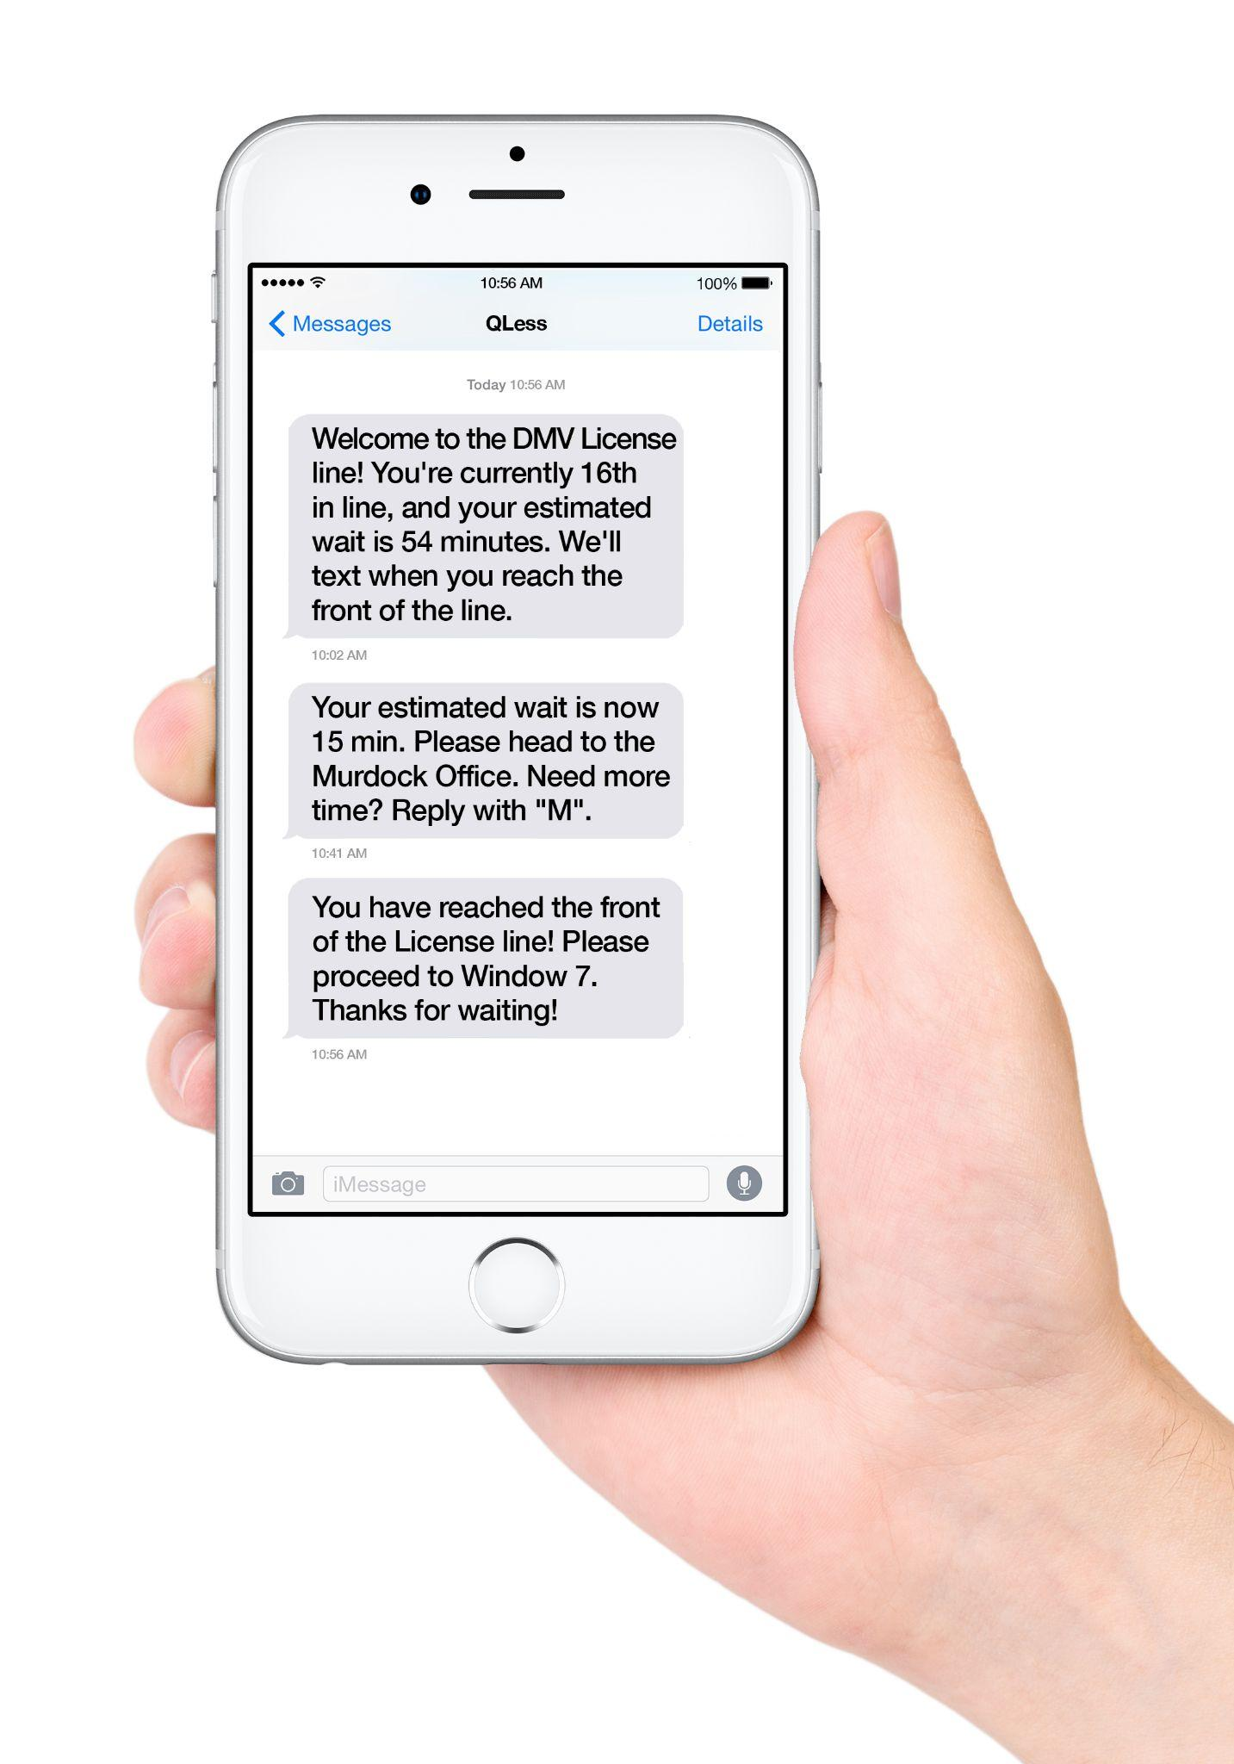
WHERE DOES IT START?
Notes:
JILL —- turn over to Danny

Slide 9
NEW MEMBER ORIENTATION
THE FIRST IMPRESSION!
Notes:
Danny

Slide 10
WHAT MAKES A GOOD NMO?
Keep Orientation light, loose & fun! This is the first impression of your lodge to the new Moose member!
Introduce yourself, your title other presenters and/or officers.
All things Moose is a mountain of information. Do not overwhelm them - keep each topic brief.
Discuss the history of your lodge
Notes:
Danny

Slide 11
WHAT MAKES A GOOD NMO?
Explain briefly about Moose International (let video do the in-depth stuff!)
Give examples of YOUR lodges community involvement, volunteer involvement. (include HOW to volunteer!)
Discuss your monthly events, SPECIAL events
Cover the “Qualified Guests” rules
Throw a “shout out” to other nearby lodges in your area!
Notes:
Danny

Slide 12
WHAT MAKES A GOOD NMO?
Explain in detail where to get more information! (social media, website, Moose International site, Info TV’s, newsletter etc…)
Play the Moose International NEW MEMBER ORIENTATION video!
Discuss Board of Officers & meeting days and times
Ask for questions!
New Member Orientations have the best impact if they run between 45-60 minutes. (Any longer and they glaze over! )
Notes:
Danny

Slide 13
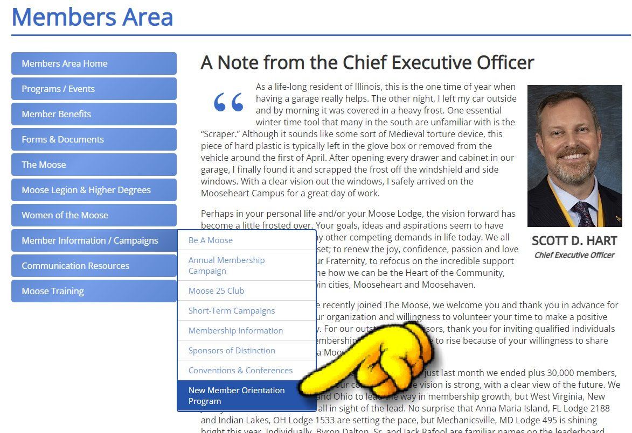
MORE
INFO!
Notes:
Danny and turn over to Theresa

Slide 14
RETENTION
Now you got them,
How do you keep them?
Notes:
Theresa - reading from her script

Slide 15
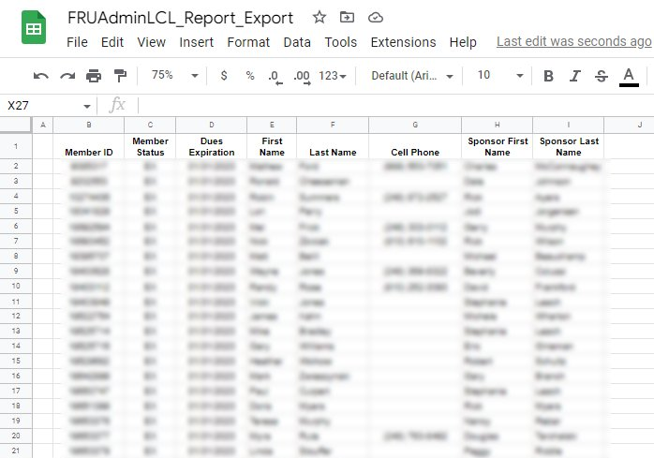
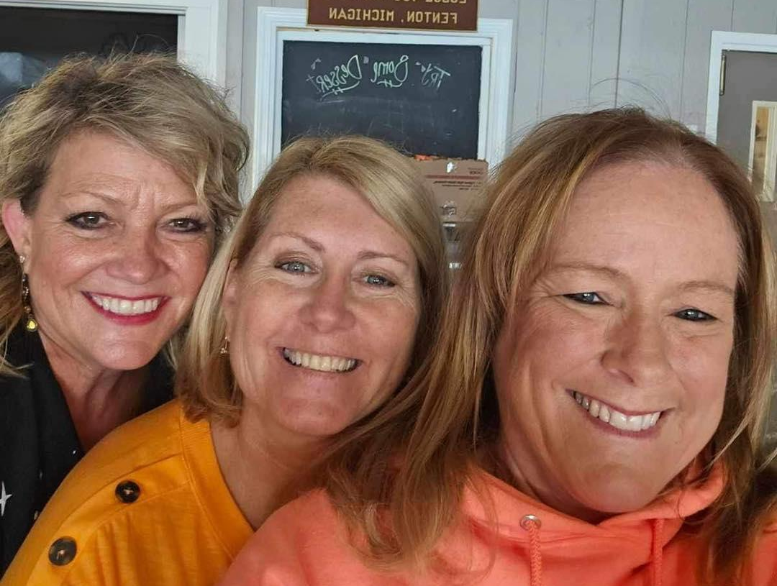
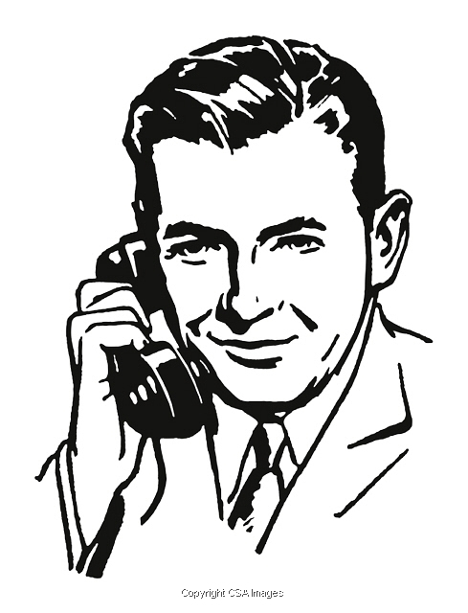
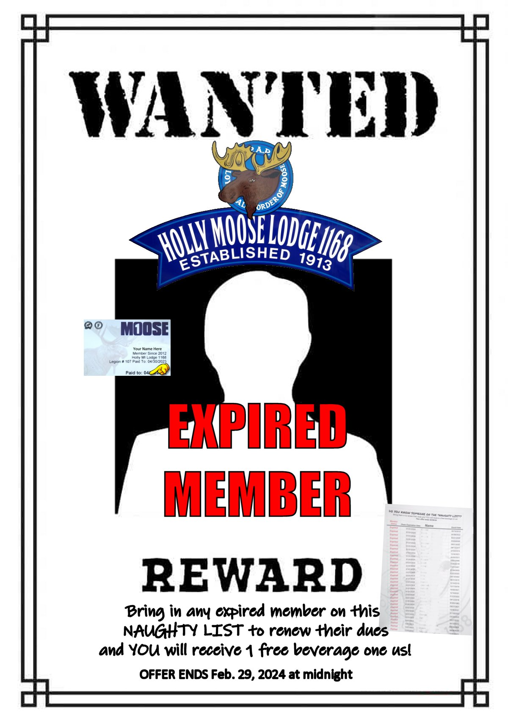
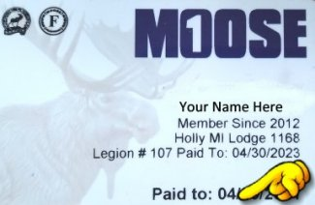
Make those calls!
Notes:
Theresa turn over to Roger

Slide 16
Notes:
Roger

Slide 17
Notes:
Roger

Slide 18
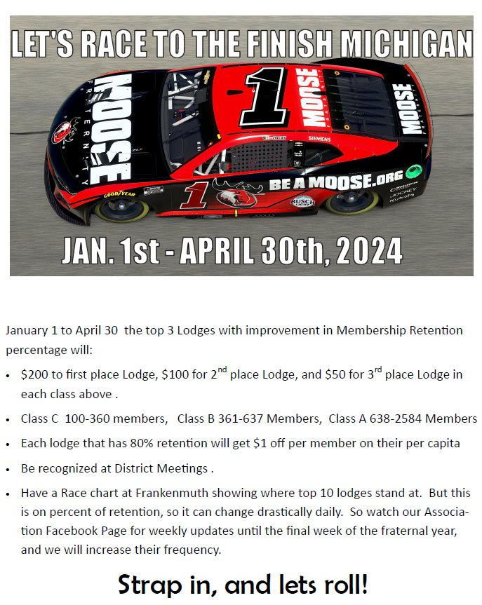
Notes:
Roger….turn over to Jim O’Connor

Slide 19
Notes:
Jim

Slide 20
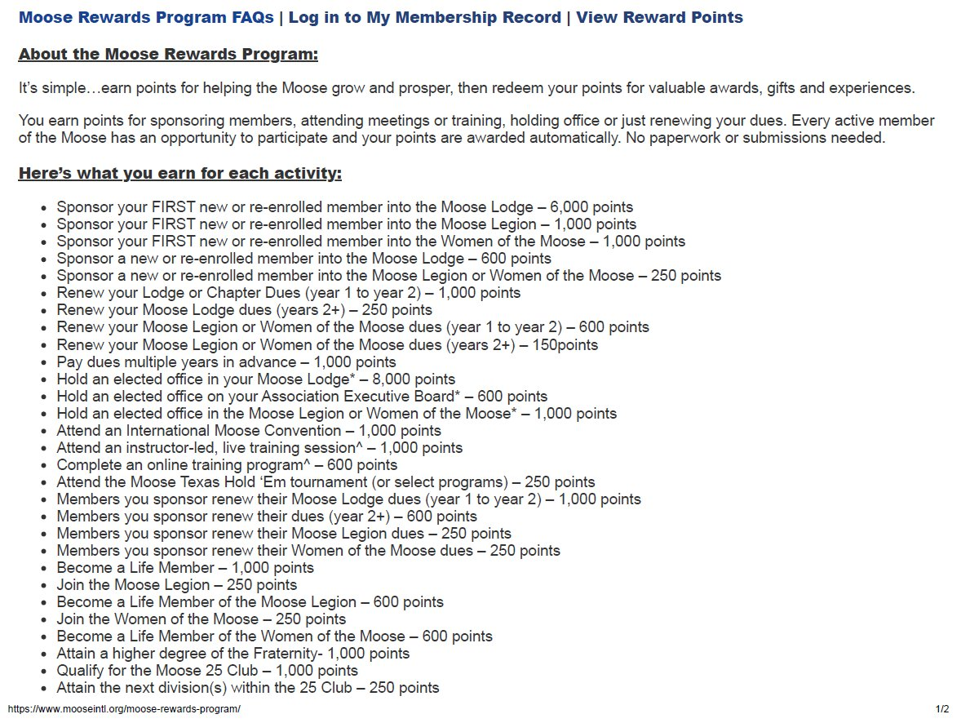
Notes:
Jim

Slide 21
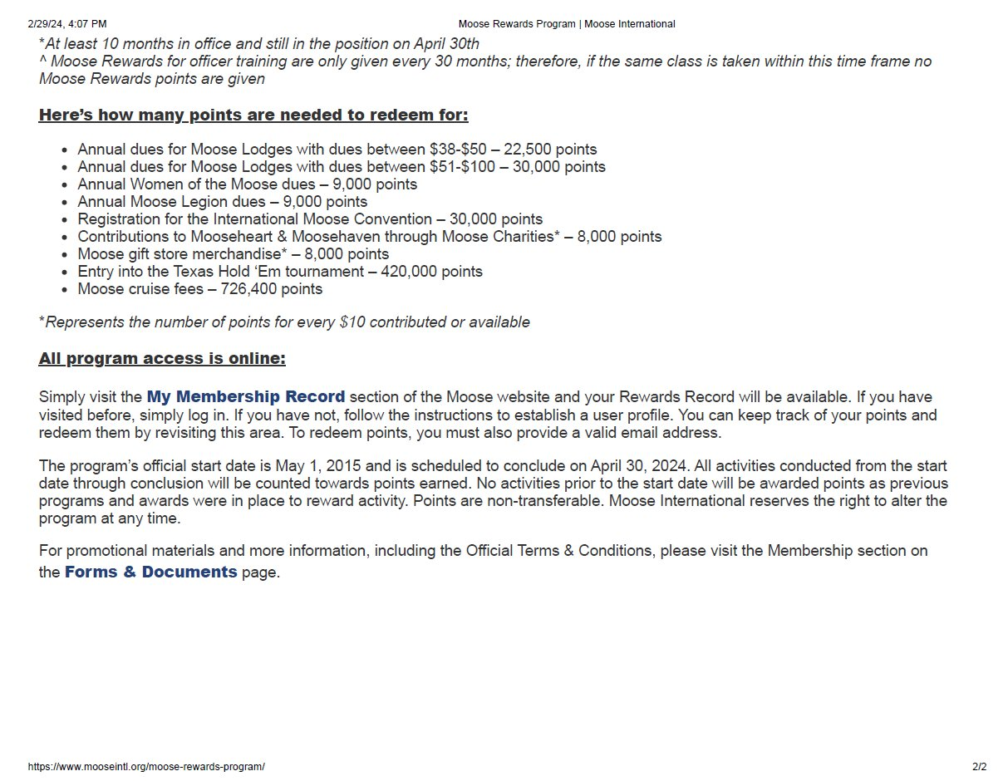
Notes:
Jim and or Roger close with next slide?

Slide 22
A lodge without members is just an empty building.
THANK YOU!
Notes:
Thanks to all and let’s RACE TO THE FINISH!

Slide 23
THE END
Notes:
Roger buys us all a drink!

