Slide 1
Let’s Talk About Dispensations

Slide 2
What is a Dispensation?
The System by which anything is administered; management
It is a checks and balances tool that management actions are legal and follow established rules

Slide 3
What is the difference between a Dispensation and a Resolution
A dispensation is for an event or special request to do something
Resolution forms are used for more actual fraternal lodge business that has been approved by the Lodge membership. Some examples are:
Resolution to sell lodge property
Resolution to merge
Resolution to lease property

Slide 4
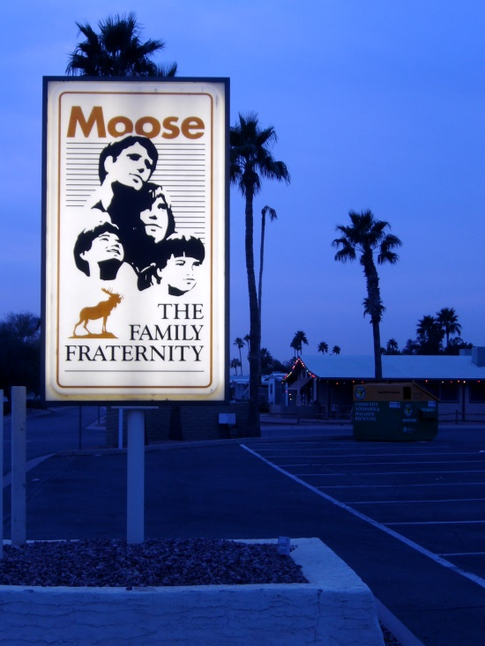
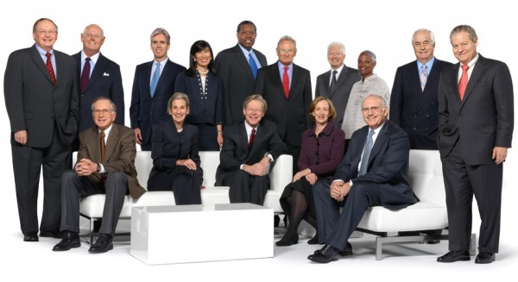
Why are Dispensations used?
To protect the lodge
To protect the lodge officers

Slide 5
Dispensations fall into 2 Types
Requiring a Special Meeting of the Membership
Only require approval of the membership at a Regular Meeting

Slide 6
What requires a Dispensation?
In the Moose; 34 items are listed on pages 131-132 of the General Laws requiring a Dispensation

Slide 7
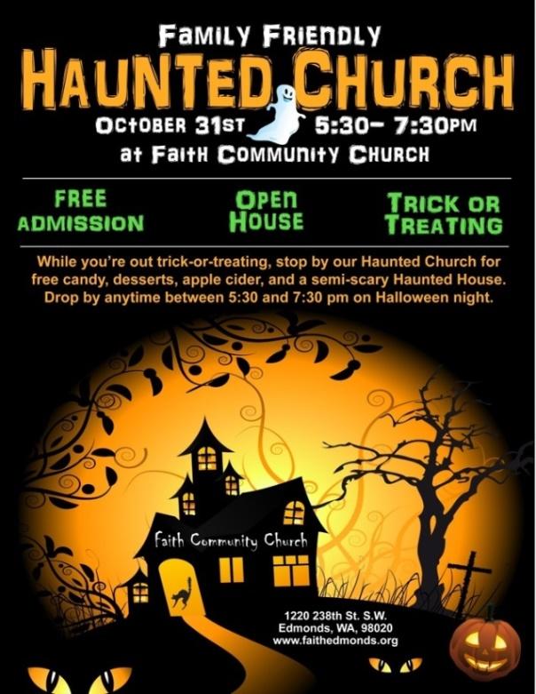
Types of Events requiring a Dispensation
Open to the Public or Open House
Community Service with or without Alcohol

Slide 8
Non-Event Dispensations
For the Election of the officers who have less than six months of membership
Keys to the Lodge

Slide 9
Non-Event Dispensations
Transfer of money
Lodge improvements over $5,000

Slide 10
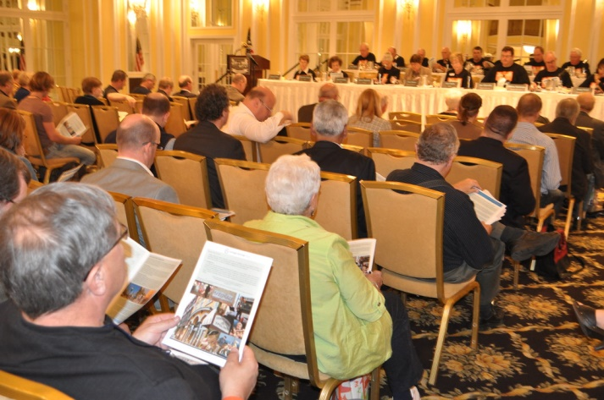
What Dispensations require a Special Meeting?

Slide 11
What Dispensations require a Special Meeting?
Acquire Real Estate
Mortgage or Sell Real Estate

Slide 12
What Dispensations require a Special Meeting?
Construct or Improve a Building
Lease Real Estate

Slide 13
What Dispensations require a Special Meeting?
Adopt original Lodge by-laws or amend by-laws
Encumber assets or affect the Balance Sheet

Slide 14
What Dispensations require a Special Meeting?
To vote on electronic notification for lodge mailings

Slide 15
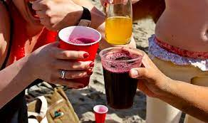
Lets look at the three different Dispensation Forms
Community Service
Involving Alcohol

Slide 16
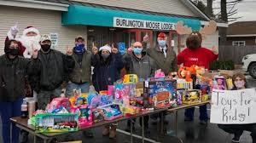
Lets look at the three different Dispensation Forms Cont.
Community Service without Alcohol

Slide 17
Lets look at the three different Dispensation Forms Cont.
A Universal Dispensation Form
Used for any other type of items not involved with Community Service

Slide 18
Where do I find the Dispensation Forms?
www.mooseintl.org
Forms and Documents
Compliance Office
Dispensations

Slide 19
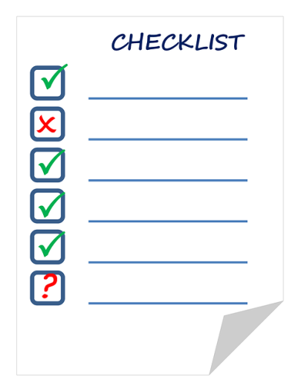
Checklist Before Sending to Chief Compliance Office
Correct Dispensation Form
Do not combine dispensation forms and make sure to put only one event on each form
Send immediately when the event is planned and approved or at least 2 weeks prior to event
Two Signatures
President
Administrator

Slide 20
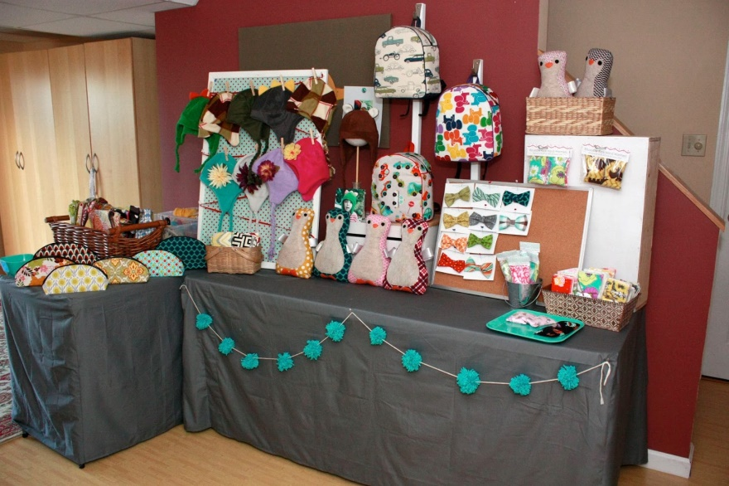
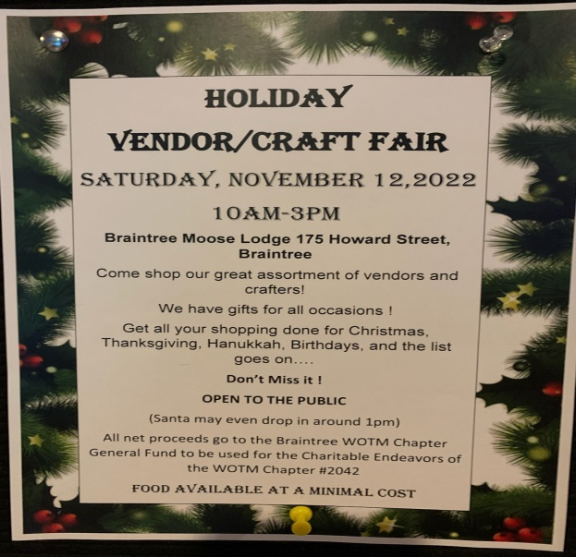
Do Chapters Need Dispensations
YES!
If chapter is holding an event open to the public the Chapter must submit Dispensation to WOTM HQ

Slide 21
What about joint Events of Lodge & Chapter?
The Lodge will file the Dispensation

Slide 22
Need help with Dispensations?
Contact your Territory Manager or Moose International Office of Compliance
It’s important for everyone to do it right

Slide 23
Contacting the Office of Compliance
Micompliance@mooseintl.org
630-966-2207 Rick King/Bethany Bowser

Slide 24
Questions

Slide 25
Thanks for Attending!
If you have comments regarding this Workshop or wish to suggest topics for a workshop please email:
Director Mike Rios at mrios@mooseintl.org

