Slide 1
Lodge activities
The path to success

Slide 2
Do you remember the l.a.m.b.s. program?
Well . . . .
Lodge Activities
still Mean Big Success!

Slide 3
What can activities do?
Build & Keep Membership
Increase Lodge Revenues $$$$
Improve attitudes – everyone loves a busy place.
Creates member comradery
Increases interest in the Moose and the Lodge

Slide 4
some top reasons members didn’t renew
There was no value in the cost of the membership . . .
We were told they had activities – NOT.
No activities – just an outdated place with old people sitting at a bar and drinking.
Where’s the value???

Slide 5
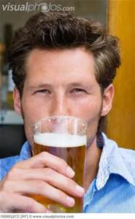
Think about this . . .
You don’t need a membership at public establishments to get a cheap – cold beer!

Slide 6
Is your lodge suffering from . . .
Declining membership?
Cash flow issues?
Unpaid taxes?
Aging membership – no young bodies to help out?
Tired Board of Officers?
More frowns than smiles?

Slide 7
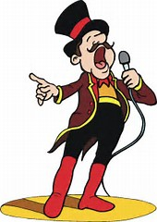
Then step up & lend us your ear . . This workshop is for you!

Slide 8
L.A.M.B.S. Lodge activities mean big success!

Slide 9
WHAT KIND OF ACTIVITIES?
Member
Entertainment
Sporting
Social
Holiday
Community
Inside the Lodge
Outside the Lodge
Let’s look at types of activities in detail . . . . .

Slide 10
entertainment
Dances
Magic Shows
Trivia

Slide 11
sporting
Card Games
Horseshoes / Bean Bags
Darts / Pool
Bowling / Shuffle Board
Golf
Basketball / Softball

Slide 12
Social
Special dinners.
Wine & Paint
Tasting parties.
Age group gatherings.
Orientations.
Gender nights.
Special Group gatherings.
Trivia
Members getting together

Slide 13
holidays
New Years’
Valentines
Spring Begins
Easter
Memorial Day
Mother’s Day
Father’s Day
Independence Day
Every month holds at least one holiday!

Slide 14
Special events
Founder’s Day
Mooseheart Homecoming
Lodge Anniversary
Chapter Anniversary
Fellowship Month
Pilgrim Month

Slide 15
Family events
Easter Egg Hunt
Visit with Santa Claus
Kids’ Crafts
Story telling
Movie night
Carnival
Halloween Party

Slide 16
Community – inside the lodge
Fund Raisers
Chamber Mixers
Recognition Events
Open Houses
Sponsorships – Scouting
Valued Veterans – Safe Surfin’

Slide 17
Community – outside the lodge
Community Service
Fund Raisers
Adopt a Highway/Park
Volunteering
Sponsorships – Youth Sports, Seniors

Slide 18
Who is going to do this?
It’s NOT up to the Administrator to carry this load by himself!

Slide 19
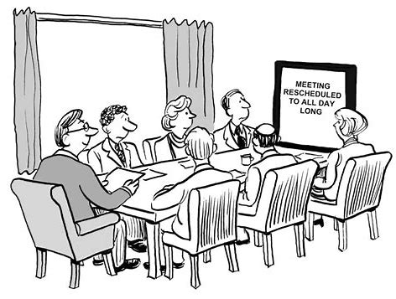
It must be a joint venture men & women
Form committees
Make the Plans
Promote the Events
Evaluate
Repeat and/or Modify

Slide 20
But . . . . .
We’re all too old!
We already tried that – it didn’t work.
We like our lodge just the way it is – we don’t need outsiders.
We can’t afford to do these events?

Slide 21
The bottom line
Your lodge can’t afford
NOT TO
host activities!

Slide 22
Here’s what we know . . .
People look for value in membership.
Values can be found in activities available and activities performed.
When value exists – People become and remain Members.
Members create income for the Lodge.
Members help create more activities.
Members generate more members.

Slide 23
Is your lodge growing & on solid financial footing?
Activities
Mean Big Success!
You MUST be willing to overcome the obstacles!

Slide 24
The reward . . . .
Growing Lodge – posed for years to come.
Financial Stability.
Happy members – Proud members – and Happy staff.
People wanting to join.
More members – even younger members willing to participate.
Success!

Slide 25
It’s you!
Taking these ideas back to your lodge.
Ready to overcome the obstacles.
Ready to form the committee – plan the events – promote the events.
Ready to revise and repeat.
Ready for success and knowing your hard efforts will achieve it!
Making your lodge viable for future generations!

Slide 26
Moose international wants to help
Mooseheart & Moosehaven depend on a strong lodge network and growing membership.
Your lodge is a keystone to the Moose Foundation –
We need You!
Your Regional and Territory Manager are willing and able to assist – reach out and tell them of your needs.

Slide 27
Thanks for participating!
The beginning of You and Your Lodge embracing L.A.M.B.S. and building for Success!
Of the Workshop . . .

Slide 28
Again - Our thanks to you!
Wish to comment about this Workshop?
Want to comment about this Presenter?
Want to recommend a Workshop Topic?
Please email: Mike Rios, Director of Membership
mrios@mooseintl.org

