Slide 1
Heart of the Community (HOC)

Slide 2
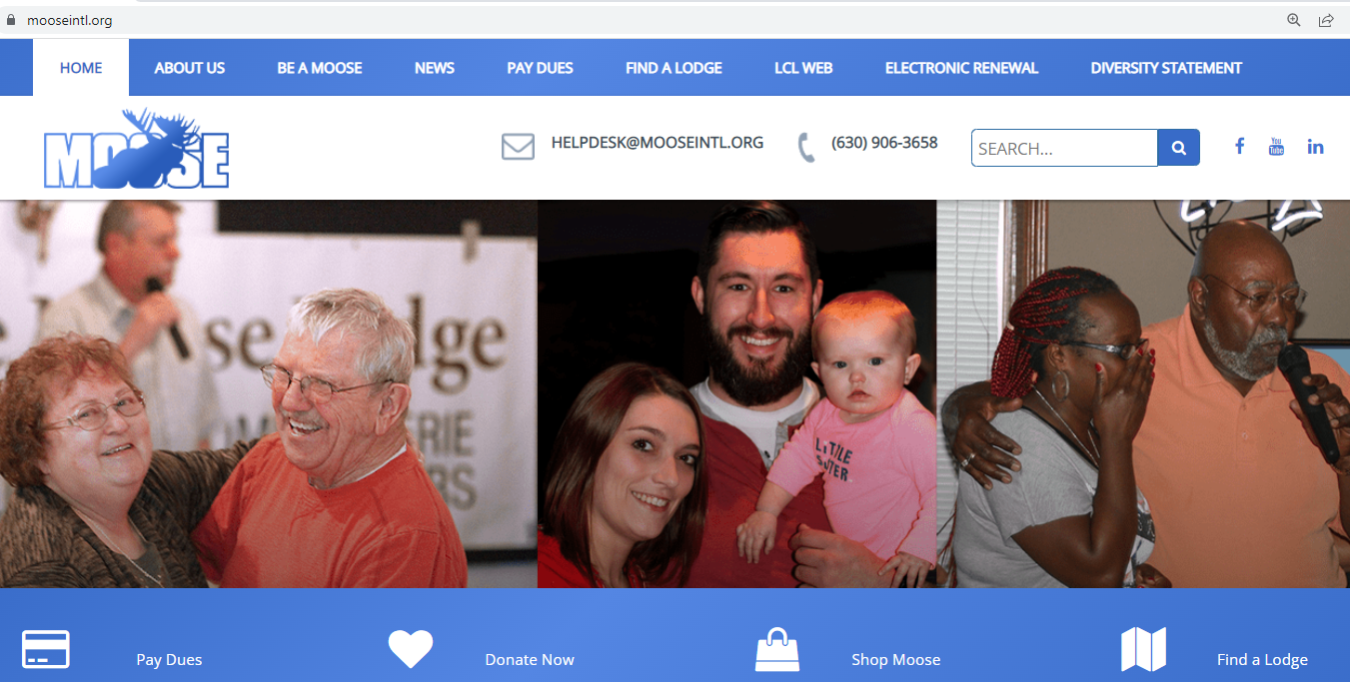

Slide 3
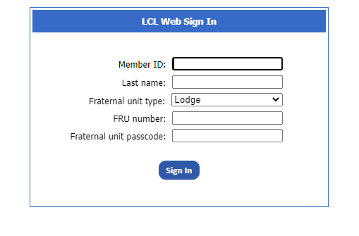

Slide 5
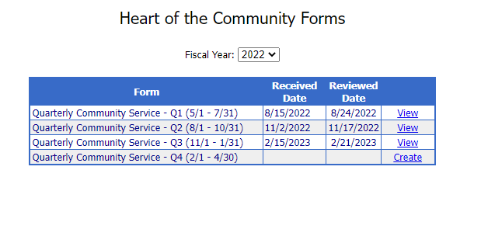

Slide 6
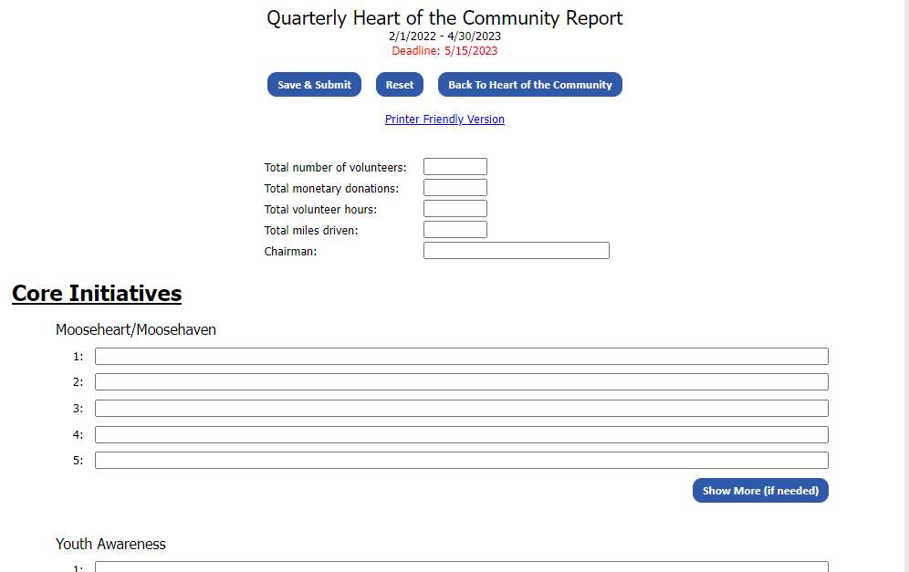

Slide 7
Core Initiatives (5 Pts.)
Mooseheart/Moosehaven
Tommy Moose
Safe Surfin
Veterans’ Program
Youth Awareness

Slide 8
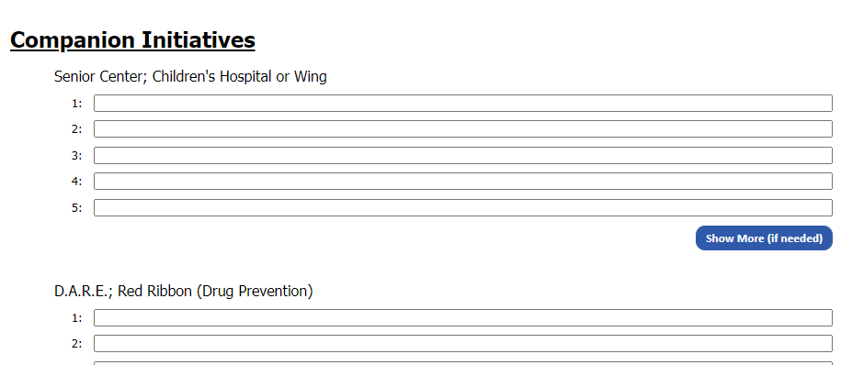

Slide 9
Companion Initiatives (3Pts.)
Sr. Care; children’s Hospital or Wing
Emergency Services
Scouting
Youth Sports
Salvation Army
Special Olympics

Slide 10
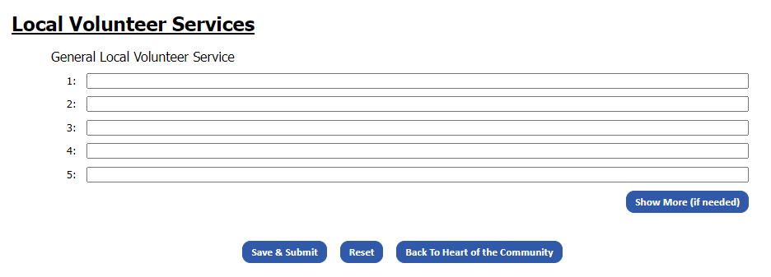

Slide 11
Local Volunteer Services(2Pts.)
Efforts made to support the community

Slide 12
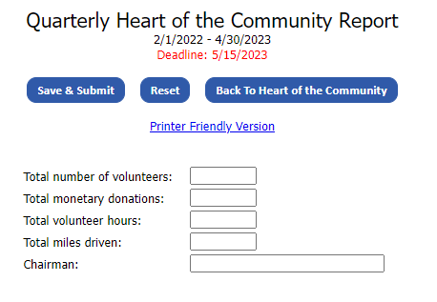

Slide 13
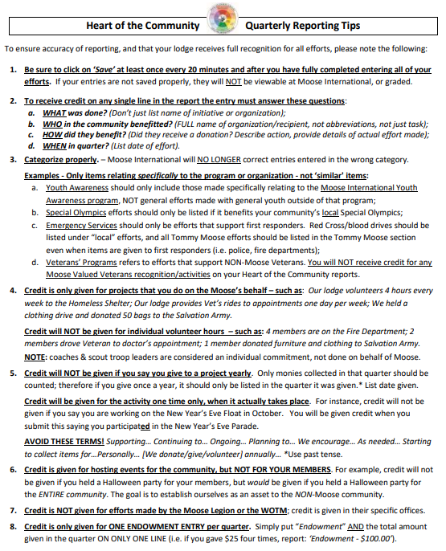

Slide 14
Due Dates!
August 15th
November 15th
February 15th
May 10th

