Slide 1
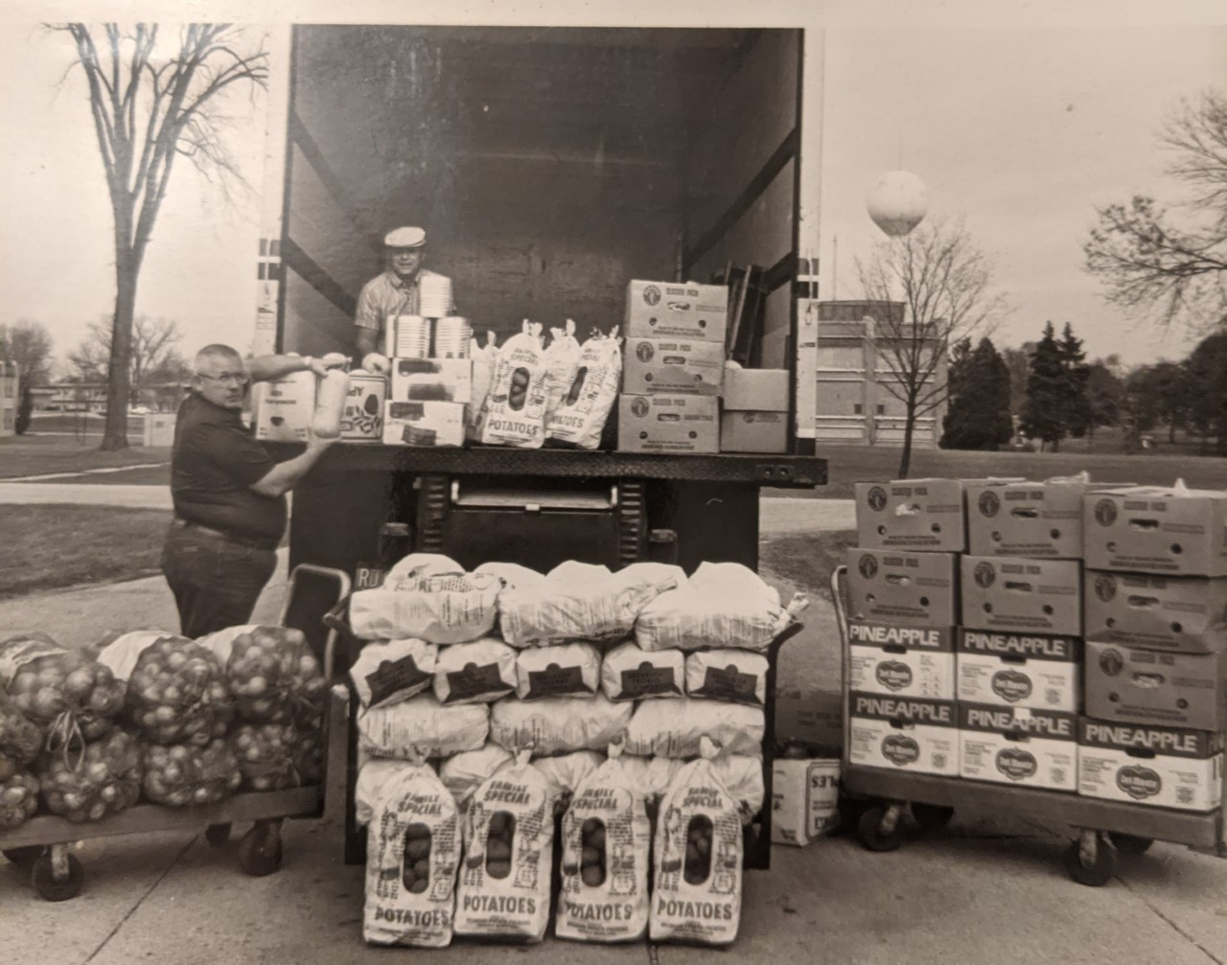

Slide 4
$16,440

